Slide 1
Let’s review…
What role do electrons play in the behavior of an atom?
How can you figure out the valence electrons? And what are they?
What is an octet and how would an atom get one?
What happens when an atom of an element has a different number of electrons?
Using the periodic table, where are the metals? Nonmetals? Metalloids?

Slide 2
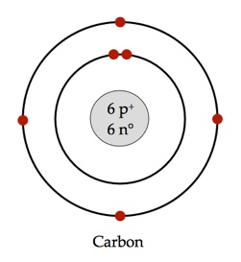
Bellwork
1. What are valence electrons?
2. How can you figure out valence electrons?
Electrons in outermost shell
group number

Slide 3
3. Each column is called a “____________________”
4. Each period represents an energy level within the atom.
5. Each element in a group has the same number of _______________________ in their outer ________________________ ________________________ (the valence level).
6. Electrons in the outer shell are called ________________________ ______________________.
group
electrons
energy
level
valence
electrons

Slide 4
Lewis Dot Diagrams
7. Lewis Dot diagrams are a notation showing the ________________ __________________ surrounding the atomic ___________________________.
valence
electrons
symbol

Slide 5
Lewis Dot Diagrams
8. First, find out which ______________________________ your element is in.
9.This will tell you the _________________________ of _______________________ electrons your element has.
10.You will ONLY draw the valence electrons.
group
number
valence

Slide 6
Lewis Dot Diagrams
Let’s try carbon.
A. Write the element symbol.
B. Carbon is in the 4th A group so 4 valence electrons.
C. Starting at the right, draw 4 dots around the symbol.
C

Slide 7
Using your periodic table, try the element in your notes.

Slide 8


Slide 9


Slide 10
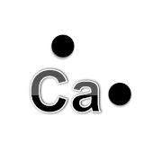

Slide 11


Slide 12


Slide 13
Al

Slide 14
11. What is a Chemical Bond?
the joining of atoms to form new substances. The properties of these new substances are different from the properties of the original elements.
What are all atoms trying to achieve?
All atoms trying to achieve a stable octet.

Slide 15
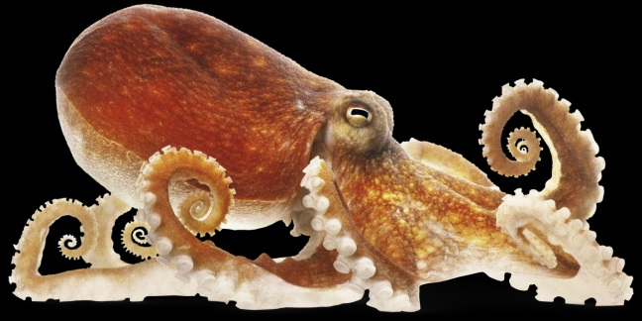
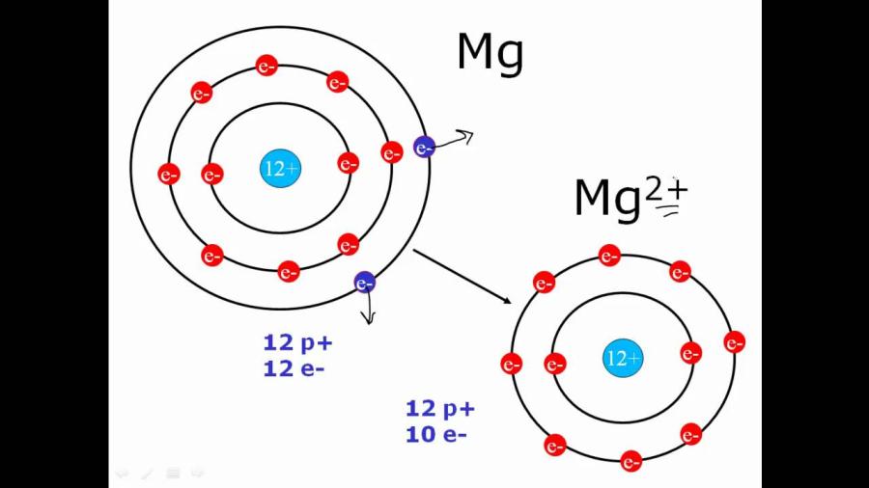
12. Describe the Octet rule.
Atoms strive to have 8 valance electrons.
(except H and He)
3) How do atoms fulfill the Octet Rule?
Atoms will lose, gain, or share electrons.

Slide 16
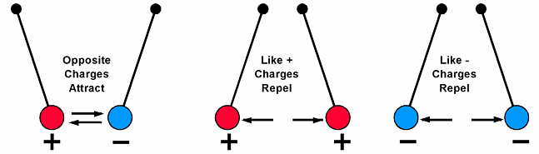
Law of Electric Charges
Things that are negatively charged and things that are positively charged pull on (attract) each other. This makes electrons and protons stick together to form atoms. Things that have the same charge push each other away (they repel each other). This is called the Law of Charges
14. Now, put it in your own words.

Slide 17
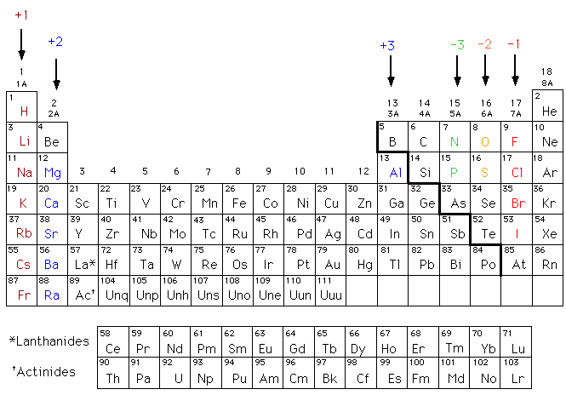
15. What is a charge?
Charge for an element to become stable

Slide 18
16. How is an ionic bond formed?
A nonmetal takes electron(s)
from an atom of a metal
a. What’s the action happening in an ionic bond?
Transferring of Electrons

Slide 19
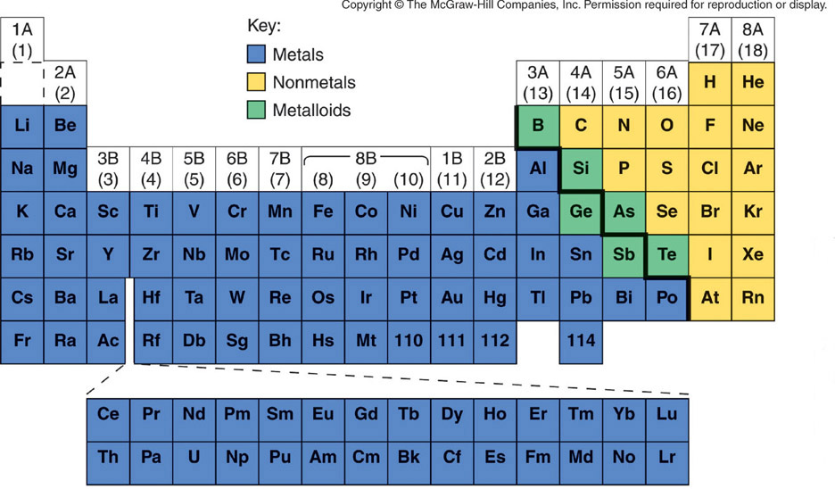
Metals and Nonmetals

Slide 20
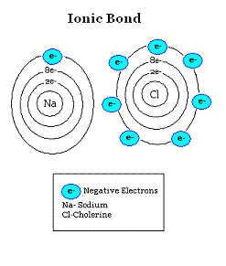

Slide 21

17. What two types of elements form ionic bonds?
Non-Metal
Metal

Slide 22
18. What particles form ionic bonds?
ION – any atom with more or
less electrons that it is
supposed to have*

Slide 23
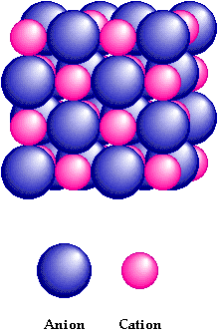
19. What are the components of an ionic bond?
Anion (-) Cation (+)

Slide 24
20. List some characteristics of substances formed with ionic bonds.
Crystalline structure
Strongly bonded
Rigid
High melting points

Slide 25
13) What is the name for an ion with a positive charge?
Metals will tend to lose electrons and become
POSITIVE CATIONS
+
+
11 p
11 e
1e
-
Na
11 p
10 e
Na
-
=
-
-
Normal sodium atom
loses one electron
to become sodium ion

Slide 26
14) What is the name for anion for an ion with a negative charge?
Nonmetals will tend to gain electrons and become
NEGATIVE ANIONS
+
+
17 p
17 e
1e
-
17 p
18 e
Cl
Cl
+
=
-
-
Normal chlorine atom
gains an electron
to become a chloride ion

Slide 27
IONIC BONDING
IS THE COMPOUND
AN IONIC COMPOUND?
Mg N
METAL
NONMETAL
3
2
SUBSCRIPTS

Slide 28

  23. Not all atoms gain or lose electrons. Sometimes they share.
  This is called a covalent bond.
Ionic
Covalent

Slide 29
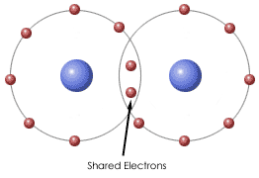
24. A covalent bond occurs when two or more nonmetals share electrons to have a full outer shell.

Slide 30
25. Which of the following are ionic and which are covalent?
Metal and nonmetal - ionic
CaCl₂→
CH₄→
H₂O→
NaF→
Nonmetal and nonmetal - covalent
Nonmetal and nonmetal - covalent
Metal and nonmetal - ionic

Slide 31
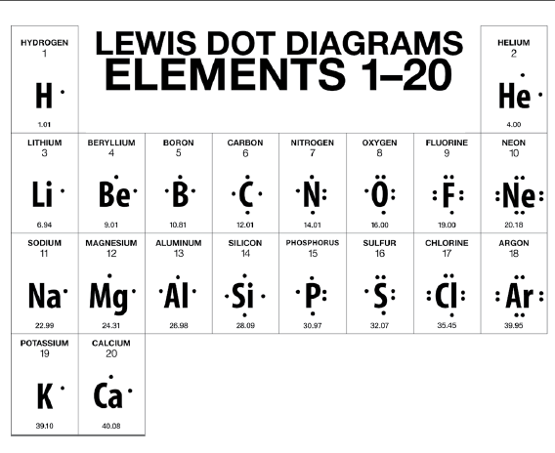
26. Let’s review how to show an ionic bond with Lewis dot structures. Use the chart for help!
Li
Cl

Slide 32

27. Let’s try a covalent bond. Use the chart for help!
F
F
Circle the shared electrons

Slide 33
28. Let’s try another covalent bond. Use the chart for help!
H
H
O
Circle the shared electrons

Slide 34
29. Some atoms bond with a double bond. Let’s try one.
O
O
Circle the shared electrons

Slide 35

30. Some atoms bond with a triple bond. Here’s an example.
Circle the shared electrons

Slide 36
31. We have seen sharing and transferring of electrons. Nonmetals share with each other, and metals and nonmetals transfer.
32. What do pure metals do?

Slide 37
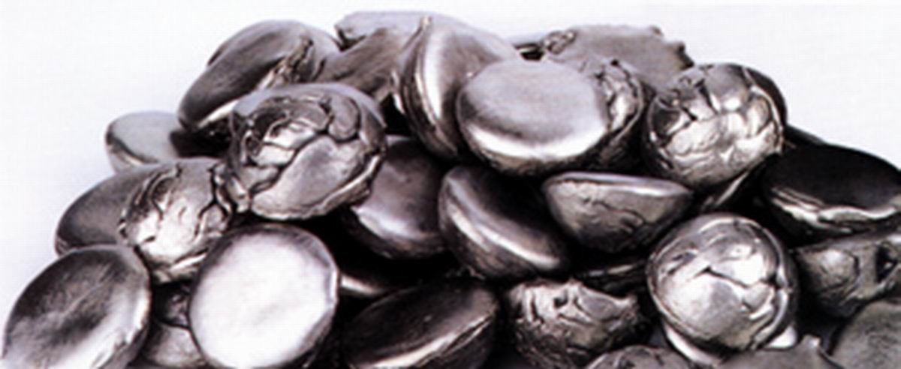
32. What do pure metals do?
Metals have metallic bonds.

Slide 38
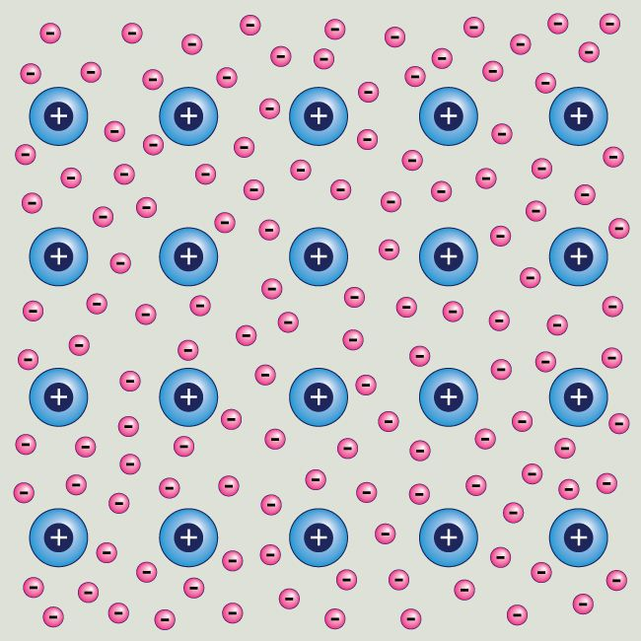
33. Metals hold onto their valence electrons very weakly. So the electrons move around the nucleus freely.

Slide 39
34. Metals in a metallic bond are like positive nuclei existing in a sea of electrons.

Slide 40
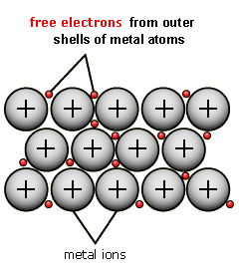
35. Let’s watch a quick video to see metallic bonding in action! Follow along in your notes.
https://www.youtube.com/watch?v=Bi0rUNV8mEw - 2:54 – 5:-05

Slide 41
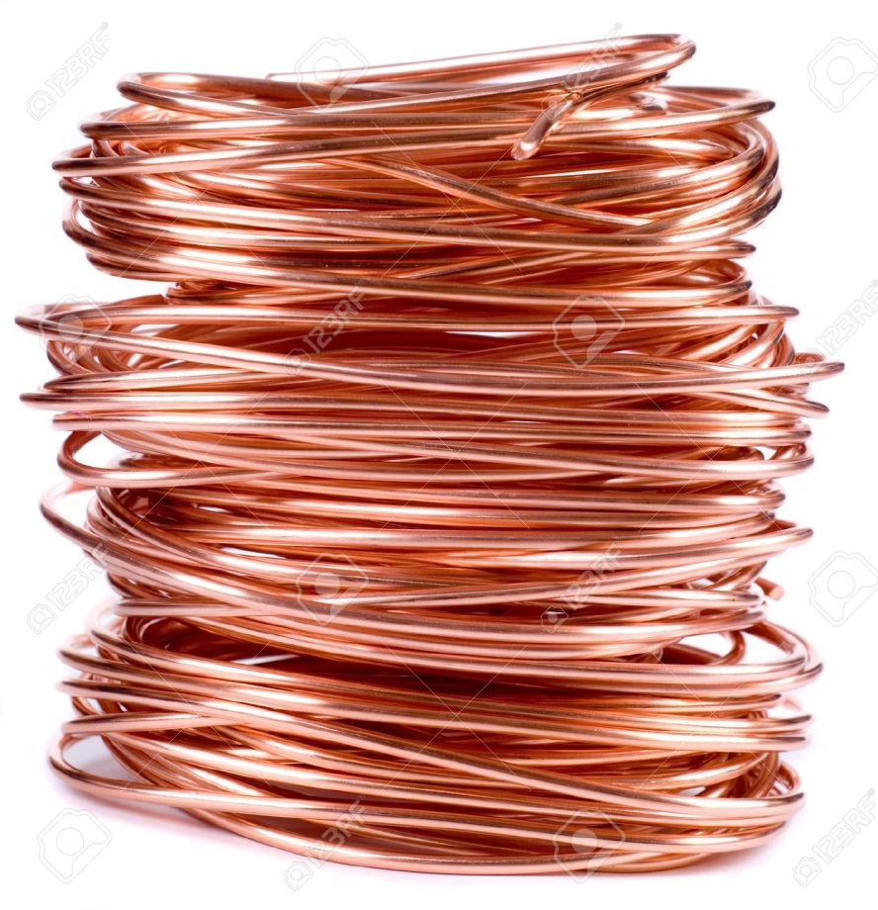
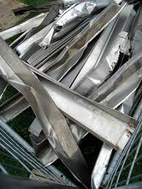
36. This is why metals conduct electricity, are malleable, are ductile, and shiny.

Slide 42
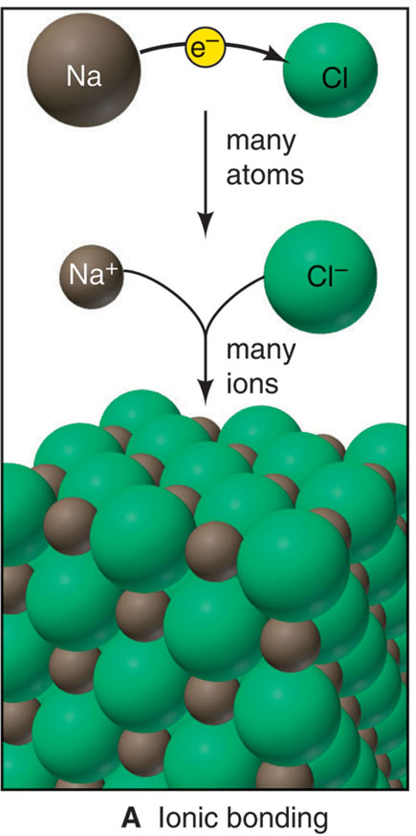
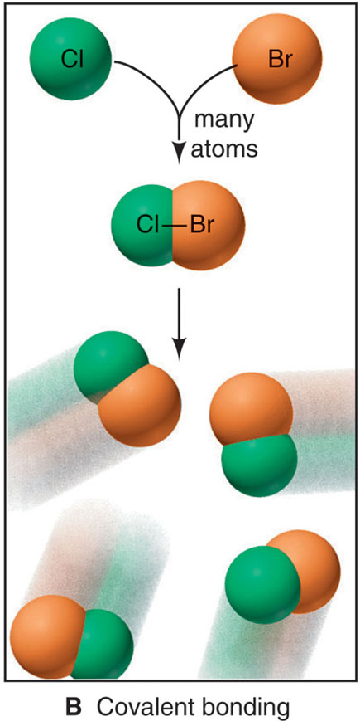
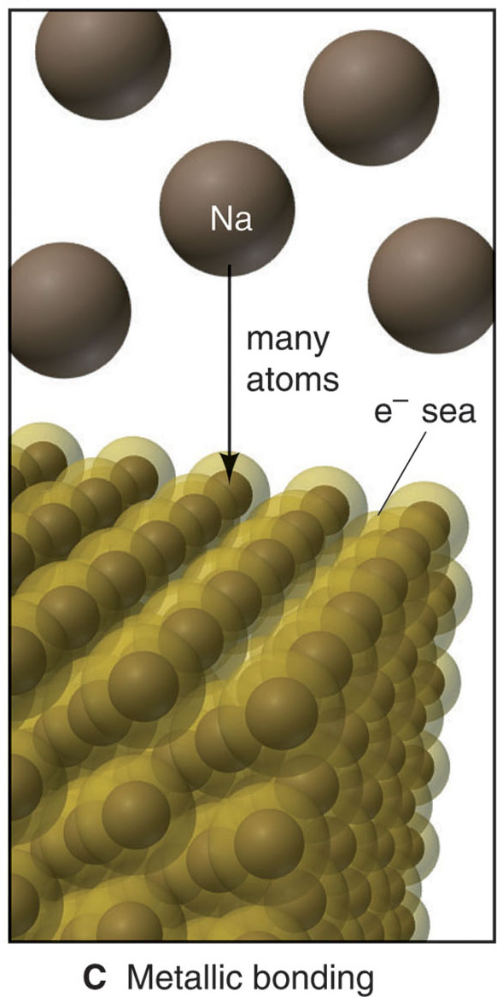
37. Three models of chemical bonding
Ionic
Covalent
Metallic
Electron transfer
Electron sharing
Electron pooling

Slide 43
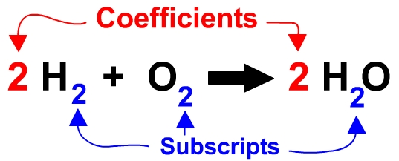
38. What is a coefficient?
Number before a molecule
Tells you number of molecules
39.What is a subscript?
Small number after an element
Tells you number of that ATOM in a molecule

Slide 44
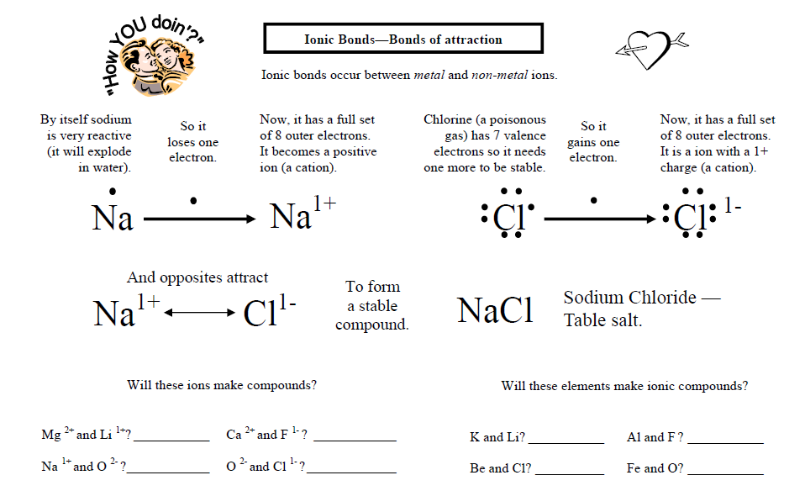
No –
both cations
yes
no
yes
yes
No – both anions
yes
yes

Slide 45
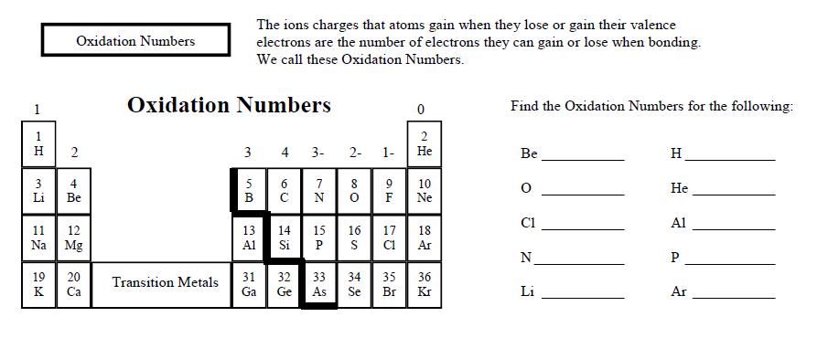
2+
1+
2-
0
(Skip a few)
1-
3+
3-
3-
1+
0

Slide 46


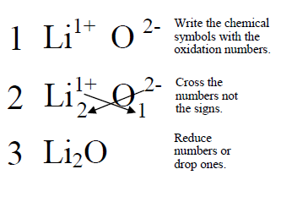

Slide 47
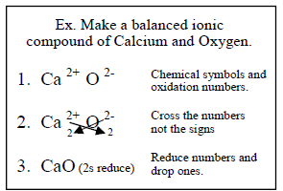

Slide 48
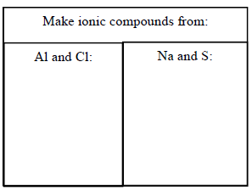
Al³⁺
Cl¹⁻
Na¹⁺
S²⁻
₁
₃
₂
₁
Al₁Cl₃
Na₂S₁
AlCl₃
Na₂S

