Slide 1
Forces In Fluids
Physical Science
3rd Period
October 7, 2015

Slide 3
Agenda: October 7, 2015
I Can Statements
Mass, Volume, and Density Video
Predictions
Density Math Practice
Independent Math Practice
Exit Slips

Slide 4
I can…
Predict densities, “sink” or “float”
Observe densities of varying materials
Explain the relationship between density, mass, and volume

Slide 6
The materials are made of …
Write what you think will happen here
Write your response here

Slide 7
Record what happened here
Write what you think will happen here
Record your observation here
Record explanation here
Block 1: Mass to volume ratio is less
Block 2 : mass to volume ratio is greater

Slide 8
Water: 1 gram per milliliter
If the object’s density is greater than the fluid then the object will sink
If the object’s density is less than the fluid then the object will float
D= m/v
D$=\frac{100g}{200ml}$ $=0.5 g/ml$
D$=\frac{100g }{37ml}=2.7g/ml$
Which one will sink and which one will float?

Slide 9
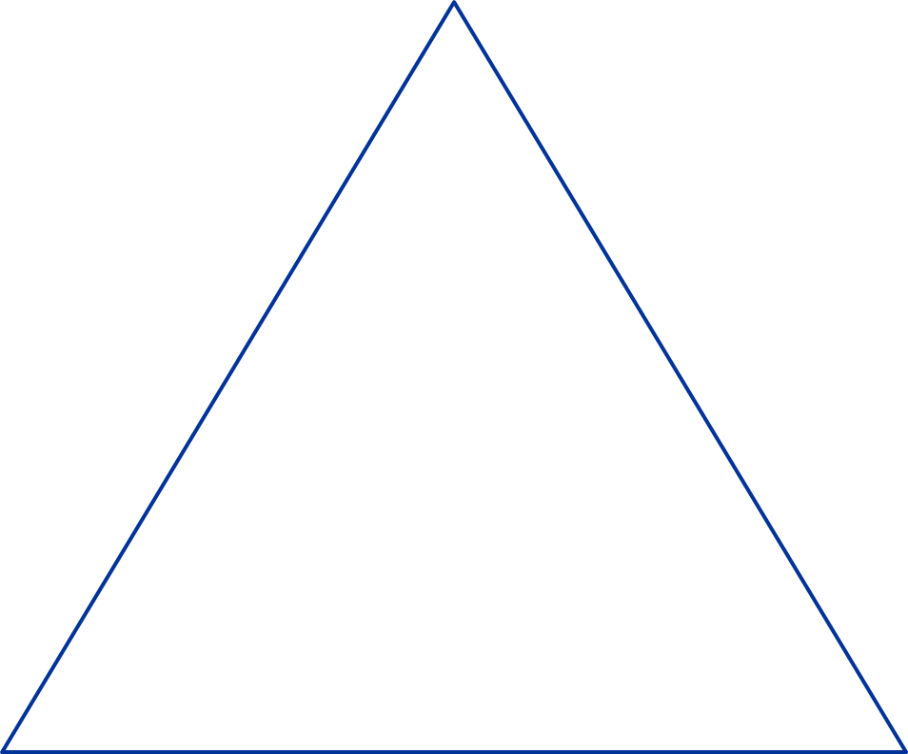
Who would like to label the diagram to represent the mathematical relationship between mass and density?

Slide 10
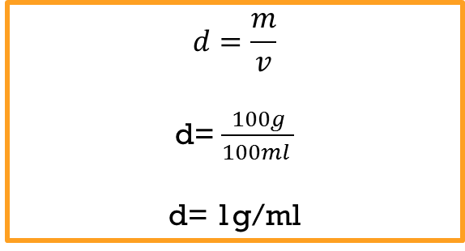
$$d=\frac{m}{v}$$
d= $\frac{100g}{100ml }$
d= 1g/ml
Suspended

Slide 11
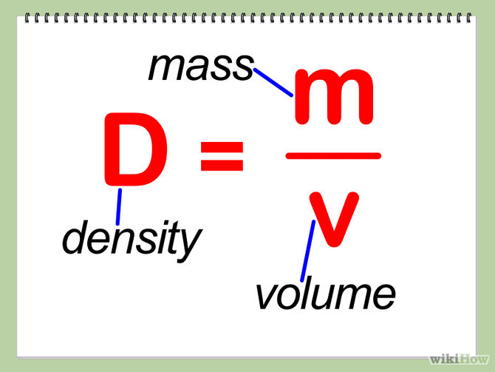
Lets practice

Slide 12
Exits Slips: Rate Yourselves
Rate yourself from 1-5 on how well you can perform the task below: 1 meaning I still need help and 5 meaning, I'm a pro
Predict densities, “sink” or “float”
Observe densities of varying materials
Explain the relationship between density, mass, and volume

