Slide 1
Energy and Work

Slide 2
What does the word “energy” mean to you?
Energy is
- a way to describe the interactions of objects
- the ability of an object to produce change

Slide 3
Energy Storage and Transfer
Mechanical energy
Kinetic energy (E_{K}) – the energy of an object in motion
Example –
Potential energy (E_{G}) – Energy stored by an object due to its position in a gravitational field
Example – lifting an object over your head
Elastic potential energy (E_{El}) – The energy stored by a material that has been stretched or compressed
Example – energy stored when pulling a bow tight

Slide 4
Energy Storage and Transfer
Electrical energy
Energy stored in an electric field (used to make charged particles move – makes electronic devices work)
Example – plugging your phone in to charge
Chemical potential energy
Energy stored and released during chemical reactions
Example – hand warmer packets
Sound energy
Energy in the motion of particles in sound waves
Example – concert

Slide 5
Energy Storage and Transfer
Light energy
Electromagnetic radiation
Example – visible light
Nuclear energy
Energy stored and released by the nucleus of an atom during nuclear reactions
Example – atomic bomb
Thermal energy
Energy of the motion of the particles of a substance
Example – boiling a pot of water

Slide 6
Kinetic energy
Energy associated with motion of an object
Note that the energy is based on the velocity of an object squared
Half the energy does not mean that the object has half of the speed it used to have
Doubling the speed makes the energy increase by a factor of 4
E_{K} = ½ m v²

Slide 7
Calculating Kinetic Energy
What is the kinetic energy of a 100 kg person running at 4 m/s?
E_{K} = ½ m v²
E_{K} = ½ (100 kg) (4 m/s)²
E_{K} = 800 J

Slide 8
Gravitational potential energy
Gravitational potential energy - E_{G}
Energy stored by the position of an object in a gravitational field
Measure of how much energy the gravitational field can transfer to an object
Depends on the mass of the object, the distance the object can fall, and the field strength (g)
E_{G} = mgh

Slide 9
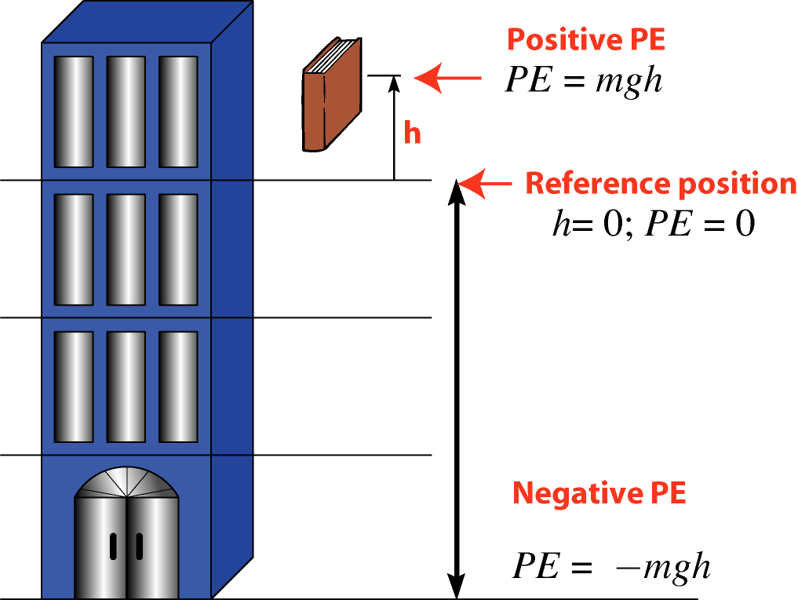
Gravitational potential energy

Slide 10
Calculating E_{G}
What is the gravitational potential energy of a 2 kg book that is sitting on a shelf 2.5 meters above the floor?
E_{G} = mgh
E_{G} = (2 kg)(9.8 m/s²)(2.5 m)
E_{G} = 49 J

Slide 11
Energy conversion in a system
Energy can be converted to another form within a system
Energy flows between forms within a system
What is a “system?”
A system is a group of objects that we are interested in analyzing and looking at
Example - pendulum swinging
The system is the pendulum bob and the Earth

Slide 12
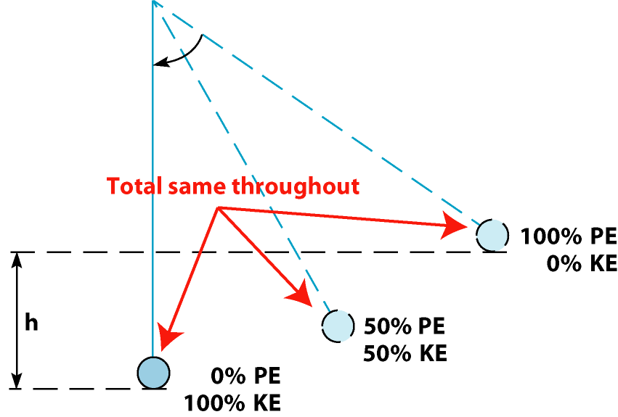
Energy conversion

Slide 13
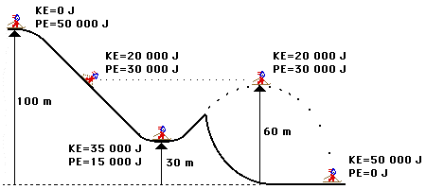
Energy Conversion

