Slide 1
Unit 7 - Electricity
The basis of electricity is the Law of Charges and the movement of electrons.

Slide 2
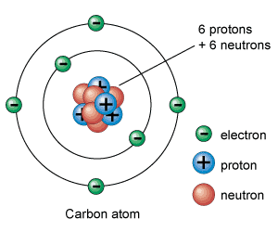
Electron Theory of Charge
Electric Charge can be ____________ or ______________
An electron’s charge is _____________ and it is found in the electron cloud outside of the _____________
A proton’s charge is ___________ and it is found in the _______________
A neutron’s charge is __________
Atoms are neutral as protons and electrons are ___________ in number

Slide 3
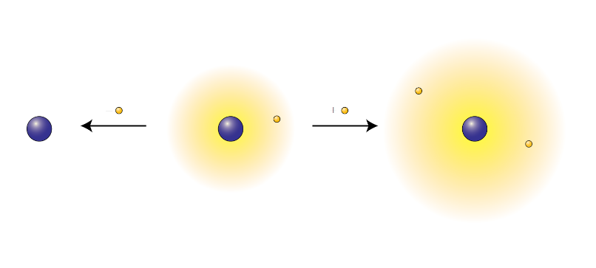
Static Electricity
Atoms can gain or lose ________________and become charged because the number of protons no longer equals the number of electrons
The number of ______________ must remain constant
Adding electrons gives rise to a ________ charge.
_________________ electrons give rise to a positive charge.
These processes create electrostatic charge which is often referred to as ____________ electricity.

Slide 4
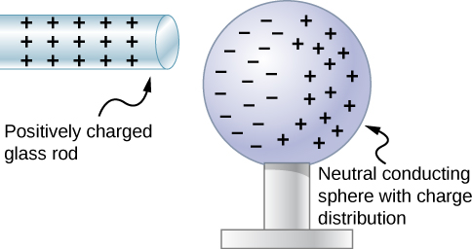
Charging an Object
Objects can become charged through several processes:
Friction - ___________ two surfaces against each other, ex. Fur and plastic rod
Contact - transferring charge by ________ a charged object against a neutral object.
Induction - by placing a charged object next to a __________ object and allowing ____________ to flow to or from the object

Slide 5
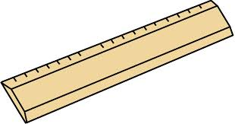
Charge transfer
Induced charges
attraction
repulsion

Slide 6
Electrical Charge
Unit is the ________________________ (C )
Symbol in equations => __________
q = n x e = (# electrons) x (electron’s charge)
e = 1.6 x 10⁻¹⁹ C/electron
e = _________________________ charge

Slide 7
Electrostatic Force
Law of Charges - similar charges _________ and opposite charges ___________.
Coulomb’s Law describes it mathematically
Force is __________ proportional to the ______________ of the charges
Force is inversely related to the _____________________
Given by the equation:
F = k q₁q₂ r²
Where k = 9.00 x 10⁹ N*m²/C²
Known as Coulomb’s constant

Slide 8
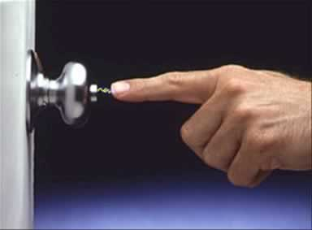
Static Discharge
stored charge in a surface is transferred quickly to another charged body
https://phet.colorado.edu/sims/html/john-travoltage/latest/john-travoltage_en.html

Slide 9
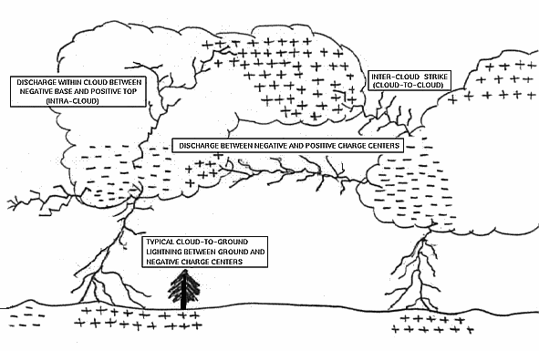

Slide 10
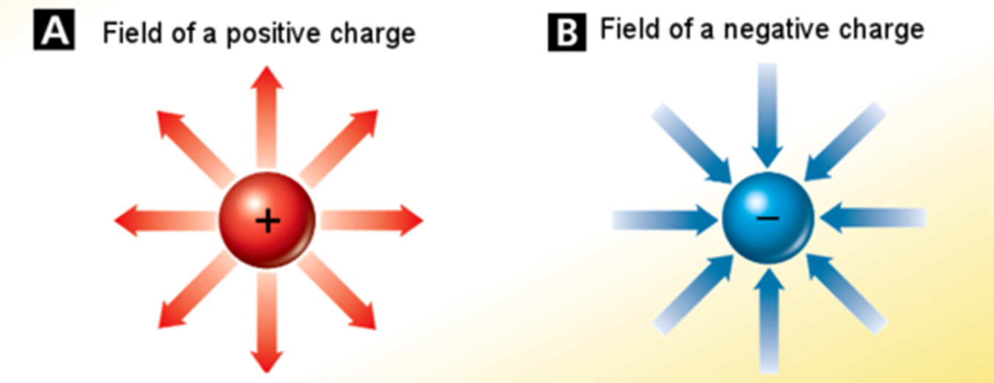
Electric Field
The space around an object that is influenced by the presence of its charge is known as ______________________.
The greater the field strength is at a point in space, the _______________ the force.
The electric field is how charges exert forces on other charges through a distance.
The direction of any electric field is defined as the direction that a positive charge would feel a force at that point in space.

Slide 11
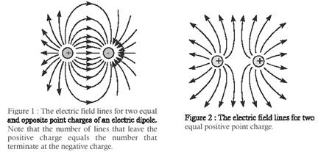
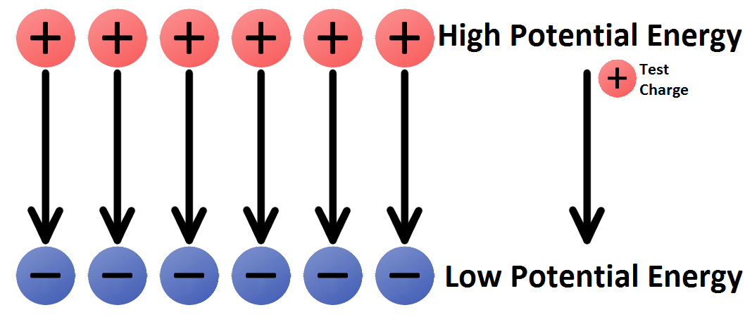
Electric Potential
Work must be done to move a charged object into a field of like charge or remove a charged object from a field of opposite charge.
Just like moving an object against gravity changes GPE, moving an object within an electrical field does the same thing.
In the same way one can change or generate electrical __________________.
The difference in electrical potential energy that arises is known as the _______________.

Slide 12
Potential Difference
Potential Difference - between the charges can be visualized when you have to work to bring two like charges together.
p.d. = work to create potential / charge moved
Unit is a volt or a joule (J) per coulomb (C )
p.d. can be measured by the ___________to move the charge or the work that charge can do.
12 volt battery does 12J of work for each coulomb of charge transferred from its terminals and vice versa.

Slide 13
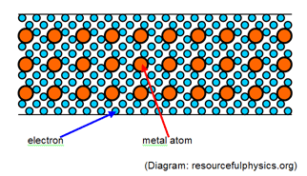
Electrical Resistance
In a conductor there are many collisions with the positive ions.
When these collisions occur the electrons lose energy.
This energy gained by the positive ions is expressed by an increase in ______________.
This results in a resistance to the flow of electrons.
This is called electrical resistance (R ).
Unit Ohm (Ω) symbol (R )

Slide 14
Electrical Current
The continuous flow of electric charge is an electric current.
Charge flows 1 direction in direct current (DC). Example: battery-operated devices
Alternating current (AC) regularly reverses Example: home and school
The SI unit of electric current is the _________(A), or amp, which equals 1 ______________.
Even though electrons flow in an electric current, scientists define current as the direction in which positive charges would flow.

Slide 15
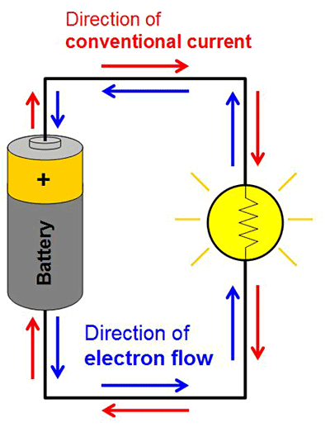
Nature of Current

Slide 16
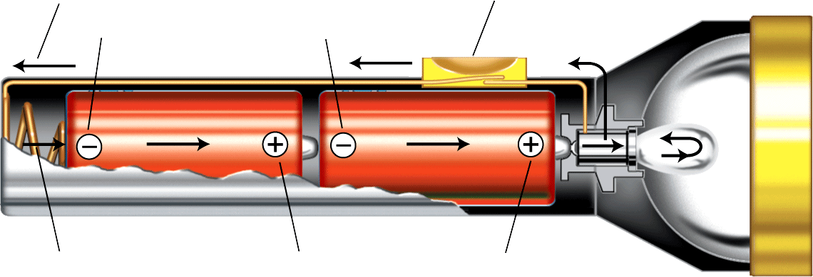
Current in a circuit
A complete path is required for charge to flow in a flashlight. Batteries must be placed so that charge can flow from negative to positive, passing through the bulb.
Flow of current
Switch
Negative terminals
Spring
Positive terminals

Slide 17
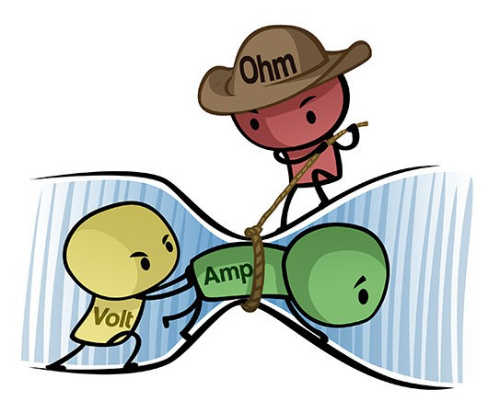
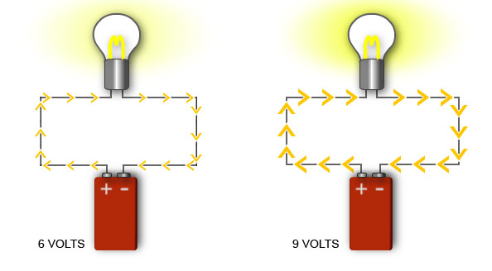
Ohm’s Law
Increasing the voltage increases the current. Keeping the same voltage and increasing the resistance decreases the current.

Slide 18
Ohm’s Law

Slide 19
Examples
Find the resistance of a portable lantern that uses a 24V power supply and draws a current of 0.80 A.
A 1.5 V battery is connected to a small light bulb with a resistance of 3.5 Ω. What is the current of the bulb?

Slide 20
Components of a Circuit
Voltage (potential difference) – This is what gets charges moving in an circuit.
Voltage (V) is measured in volts (V) in the SI system.
Current – the rate of movement of charges through a conductor.
Current (I) is measured in amperes (A) in the SI system.
Resistance – Internal friction that slows the movement of charges through a conductor.
Resistance (R) is measured in ohms (Ω) in the SI system.

Slide 21
Two Types of Circuits

Slide 22
1. Draw a circuit with 3 bulbs in series with a two cell battery and a closed switch.

Slide 23
2. Draw a circuit with 3 bulbs in parallel, two motors in series, a two cell battery and a closed switch.

Slide 24
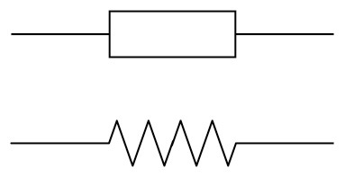
3. Draw a circuit with 2 resistors, a one cell battery, and an open switch.

Slide 25
4. Draw a circuit with 3 bulbs in parallel, one buzzer (not in parallel), and a two cell battery.

Slide 26
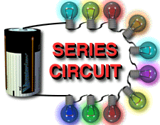
Series Circuits
Series circuits have a single path for the current to flow.

Slide 27
Resistance in Series
In a series circuit the current passes through all the resistance.
The current only has one place to flow.
The total resistance in the circuit is the sum of the individual resistances.
R_{s} = R₁ + R₂ + R₃ + …

Slide 28
Example
Three resistors with resistance of 12, 8, and 24 ohms are in a series circuit with a 12 V battery. (A) What is the total resistance of the resistors? (B) How much current can move through the circuit? (C) What is the current through each resistor?

Slide 29
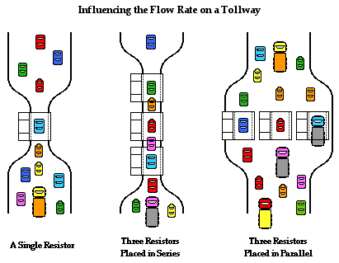
Resistance and Voltage in Parallel
In a parallel circuit the voltage across each resistance is the same, but the current through each resistance may vary.
The current travels the path of least resistance.
The following equation is used to calculate the equivalent parallel resistance.
1/R_{p} = 1/R₁ + 1/R₂ + 1/R₃ + …
The total resistance in a parallel circuit is always less than the smallest parallel resistance.

Slide 30
Example
Three resistors with resistance of 12, 8, and 24 ohms are now connected in parallel with a 12 V battery. (A) What is the combined resistance? (B) What is the current in the overall circuit? (C) What is the current through each resistor?

