Slide 1
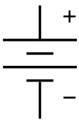
1. Draw a circuit with 3 bulbs in series with a two cell battery and a closed switch.
What’s wrong with this?

Slide 2
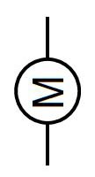
2. Draw a circuit with 3 bulbs in parallel, two motors in series, a two cell battery and a closed switch.

Slide 3
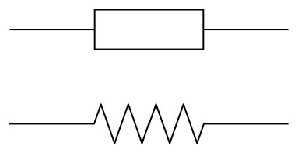
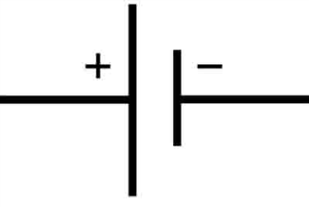
3. Draw a circuit with 2 resistors, a one cell battery, and an open switch.
Would current be flowing in this circuit?

Slide 4
4. Draw a circuit with 3 bulbs in parallel, one buzzer (not in parallel), and a two cell battery.

