Slide 2
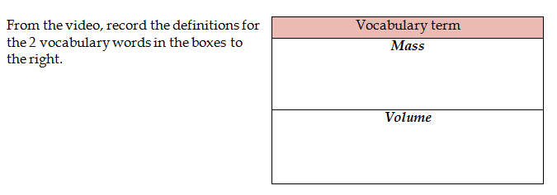
Click here for the video!
Measurement of the amount of matter
Measurement of the space it occupies

Slide 3
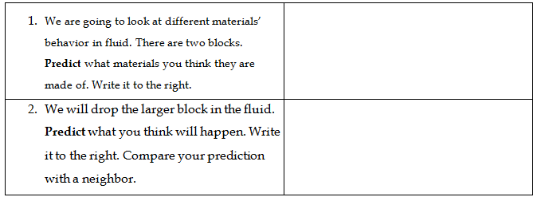
Whatever you think!
Whatever you think!

Slide 4
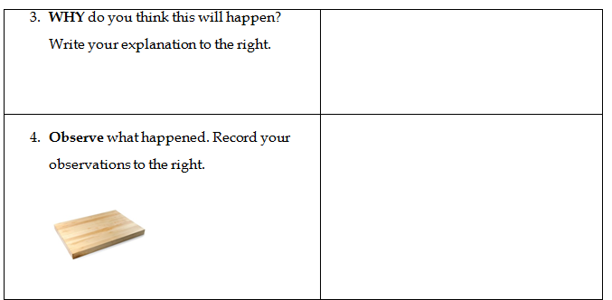
Whatever you think!
Use your senses!

Slide 5
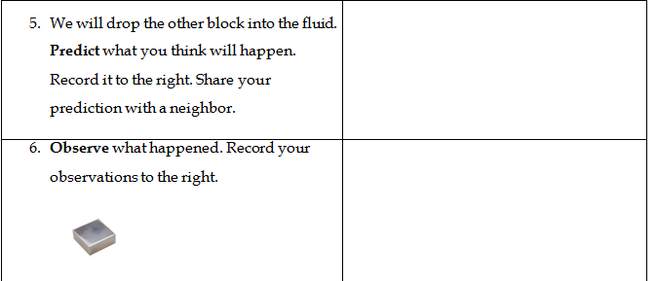
Whatever you think!
Use your senses!

Slide 6
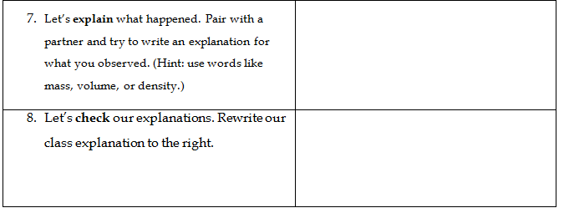
Because of the mass/volume…
The object with a higher mass per volume is more likely to sink.

Slide 7
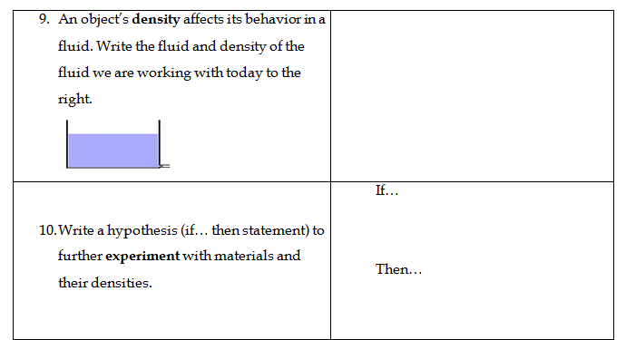
Water: 1 g/mL
an object’s density is greater than 1
it will sink in water.

Slide 8
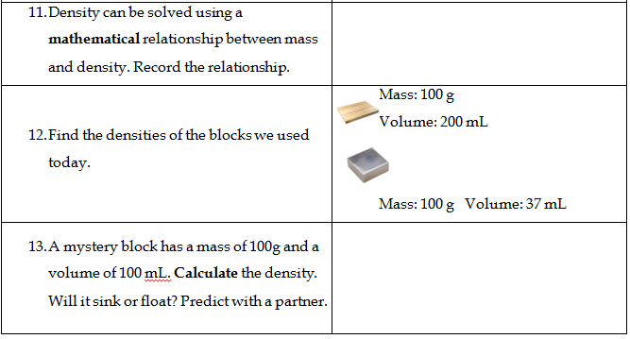
D =$\frac{m}{v}$
D =$\frac{100g}{200ml}$
=0.5g/ml
D =$\frac{100g}{37ml}$
=2.7g/ml
D =$\frac{m}{v}$
D =$\frac{100g}{100ml}$
=1g/ml
suspends!

Slide 9
Try some on your own! Get your teacher’s initials for the points for each question.

