Slide 1
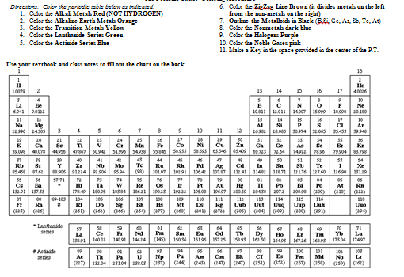

Slide 10
group
period

Slide 11
1
Very reactive
Do not occur freely in nature
Li
Na
K

Slide 12
2
Very reactive
Do not occur freely in nature
Be
Mg
Ca

Slide 13
vary
Sometimes conductive
Properties of nonmetals and metals
Si
Ge
As

Slide 14
7
Highly reactive
Vary in state-- solid (I₂) to liquid (Br₂) to gaseous (F₂and Cl₂)
F
Cl
Br

Slide 15
8
Inert (nonreactive)
Odorless and colorless
He
Ne
Ar

