Slide 1
2
Hottest stars?
Biggest stars?
Brightest stars?
1
3

Slide 2
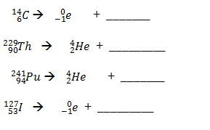




14
$${}_{7}^{}N$$
225
$${}_{88}^{}{Ra}$$
237
$${}_{92}^{}U$$
127
$${}_{54}^{}{Xe}$$

Slide 3
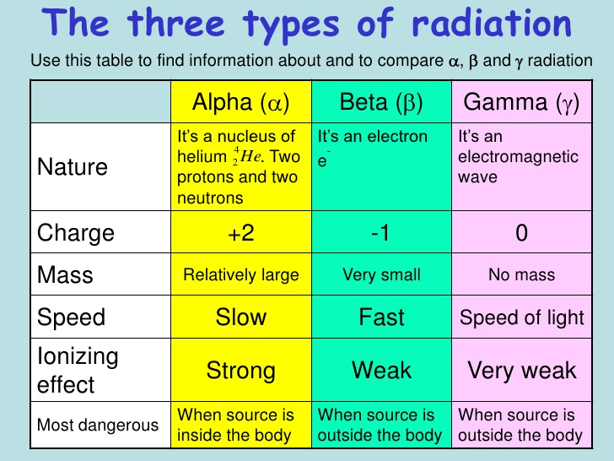

Slide 4
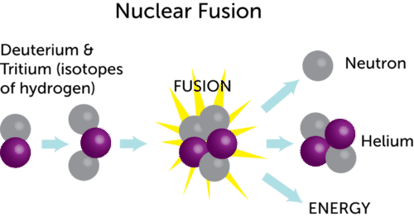
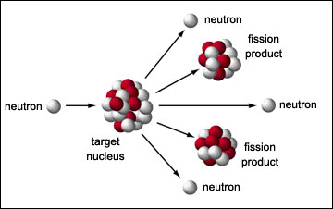
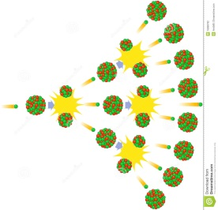
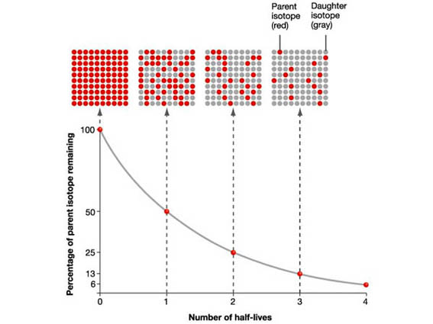
Nuclear Fusion?
Nuclear fission?
Chain reaction?
Half-life?

Slide 5
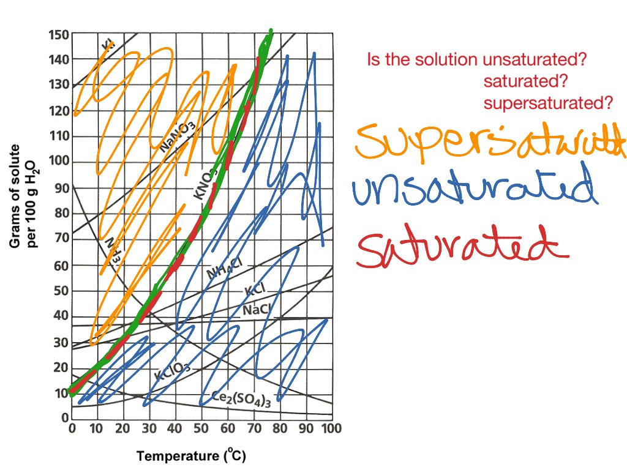

Slide 6
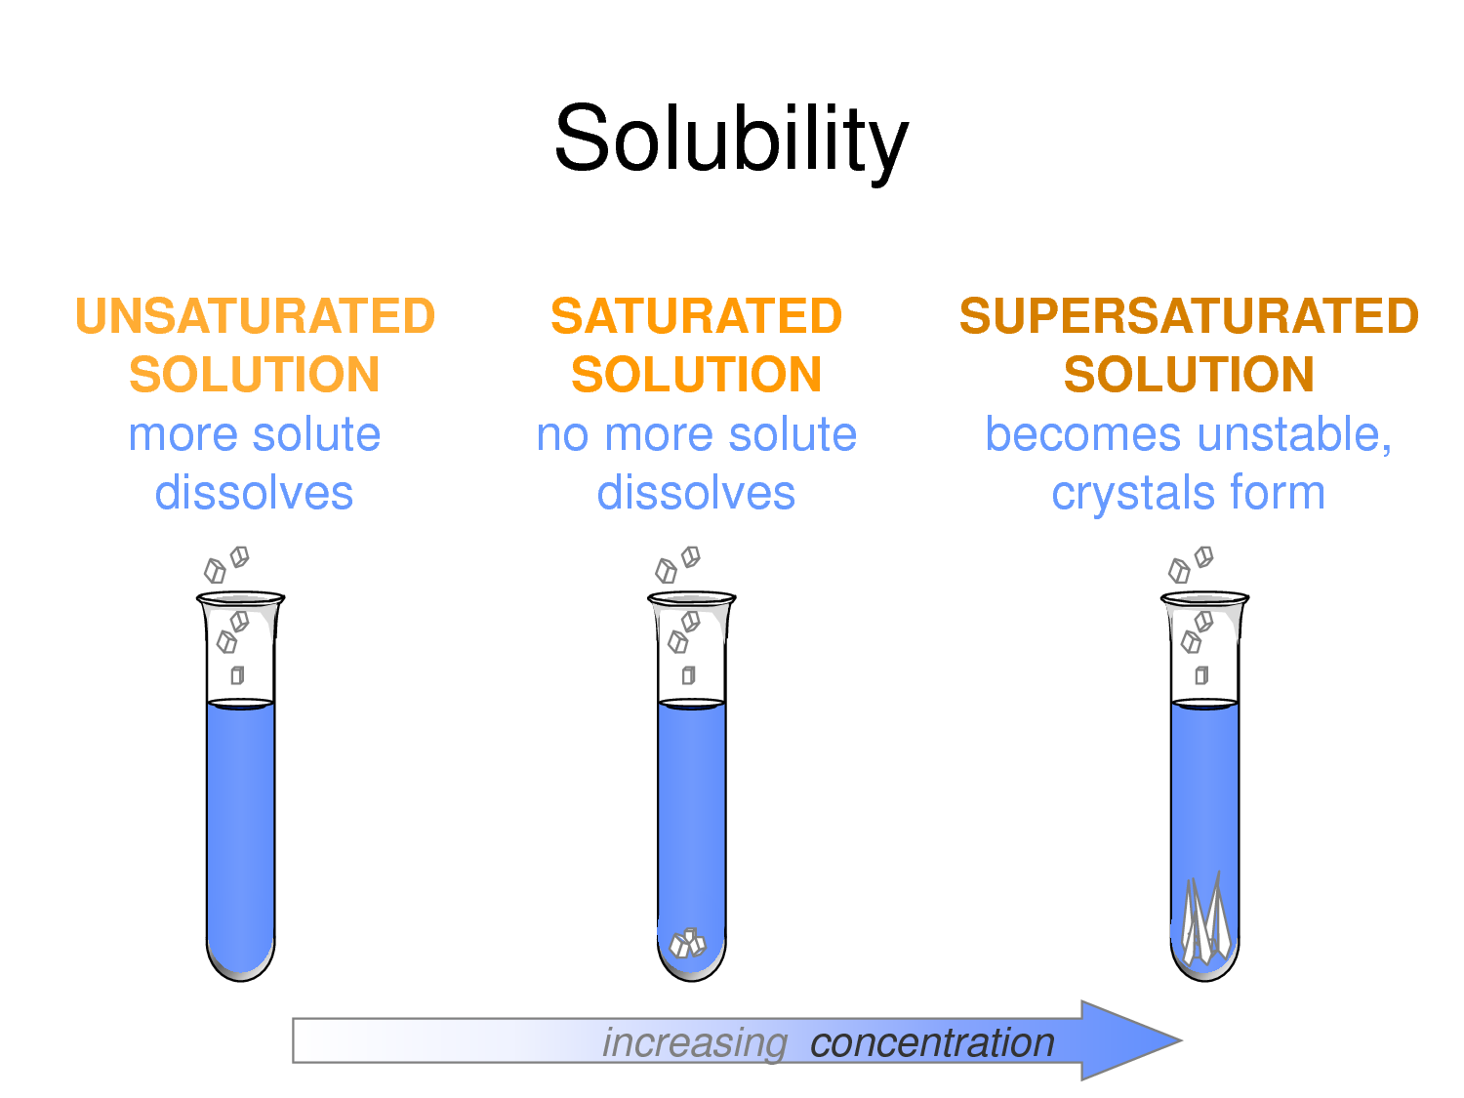

Slide 7
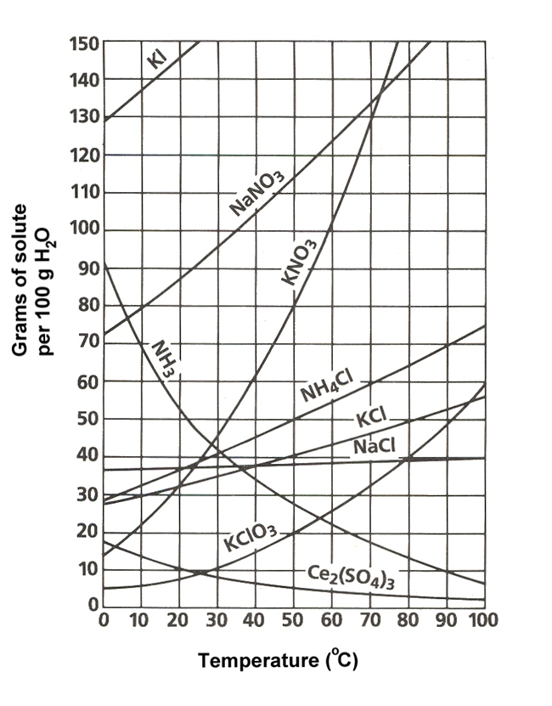
Least soluble at 5 degrees?
How many grams can dissolve of NaNO₃ at 70 degrees?
Cool NH₄Cl from 70 to 30 degrees. How much precipitates?

Slide 8


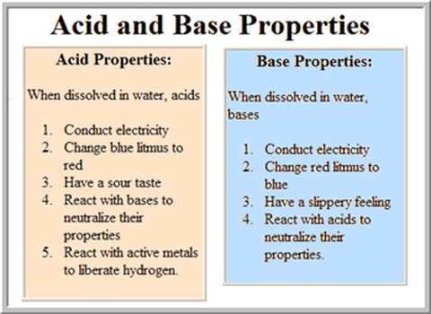
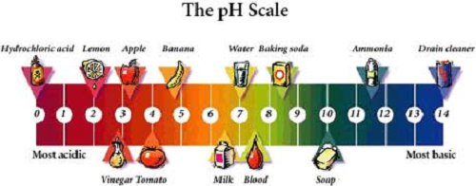
Acids…? Bases…?

Slide 9
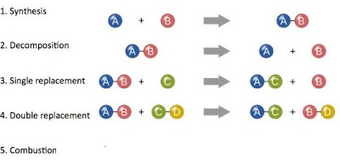
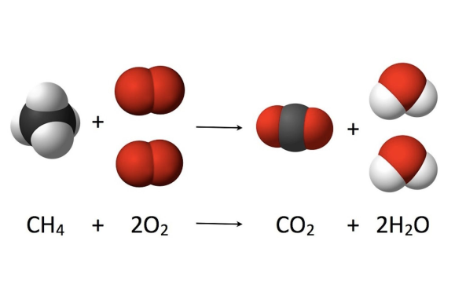

Slide 10
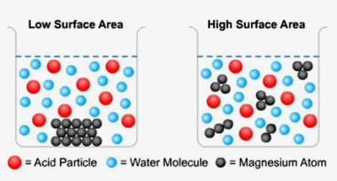
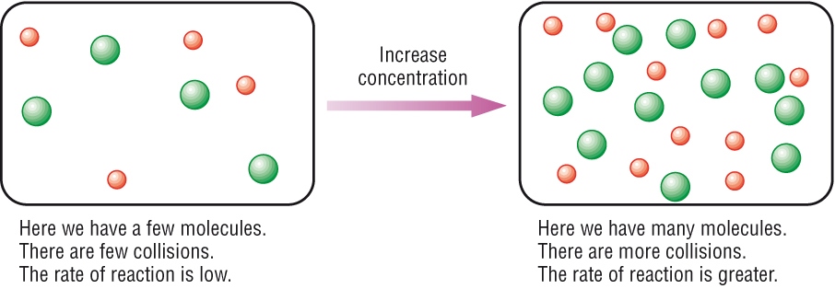
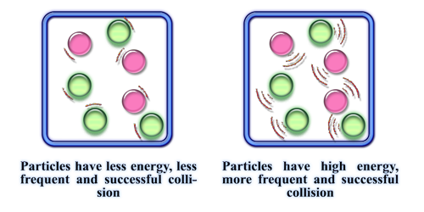
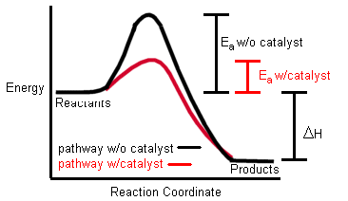

Slide 11
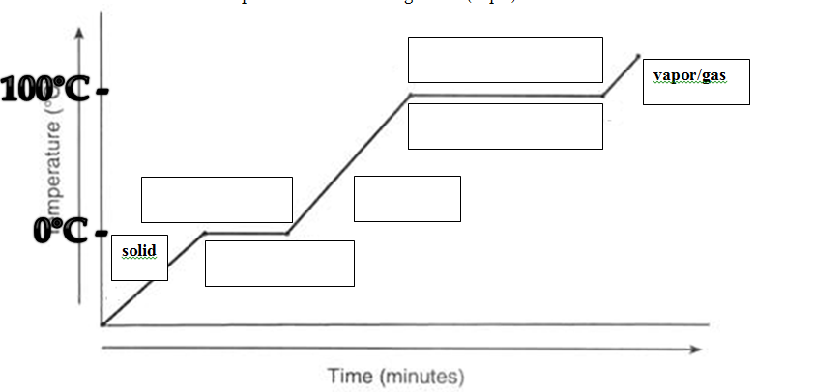
evaporating
condensation
melting
liquid
freezing

Slide 12
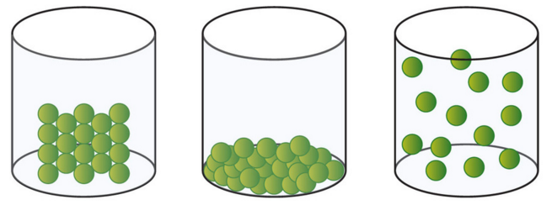
States of Matter

Slide 13
Tomorrow we will review…
  Balancing
  Mixtures & Physical/Chemical properties
  Heat problem
  Periodic Table
  Electron configurations
  Bonding
  Naming

Slide 14
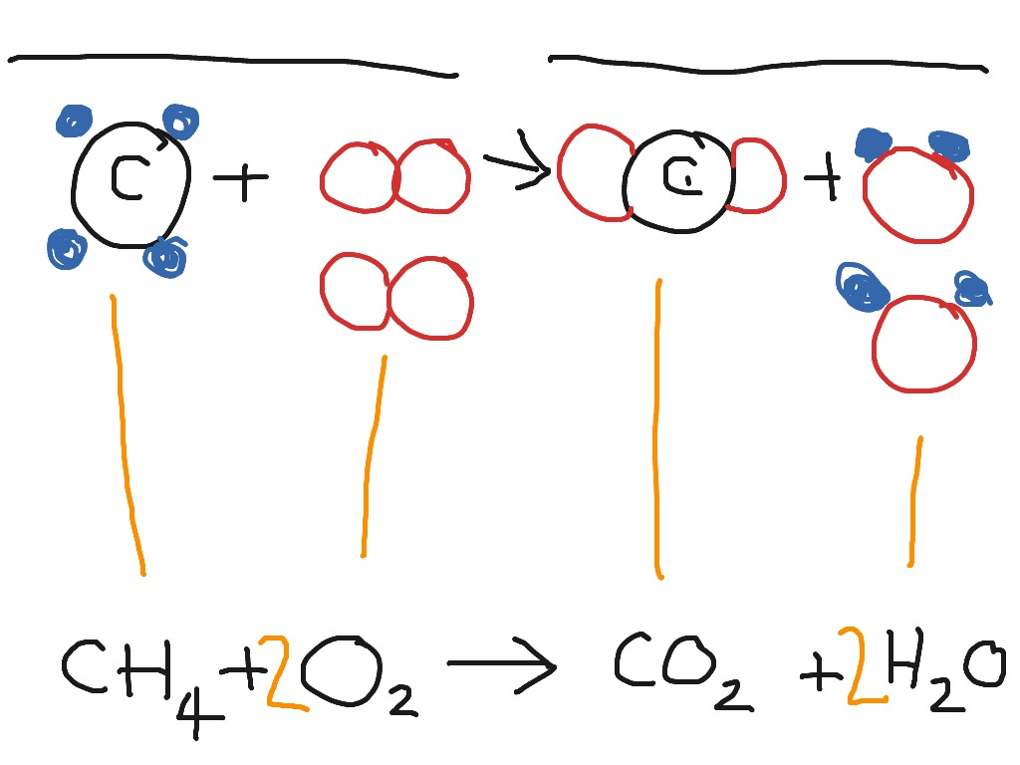

Slide 15
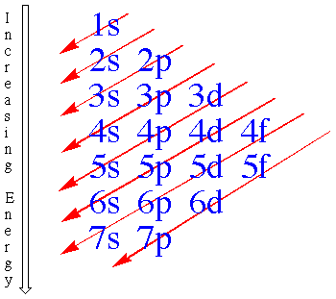
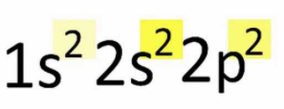

Cl
C
B

