Slide 1
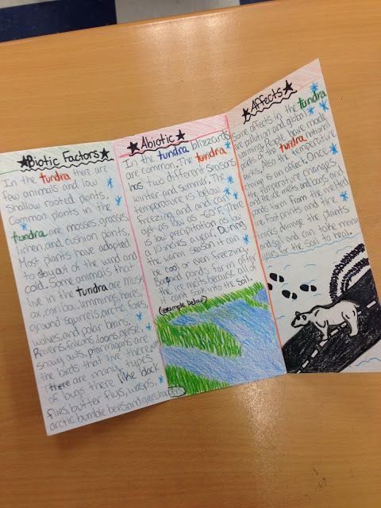
Making a Useful Resource

Slide 2
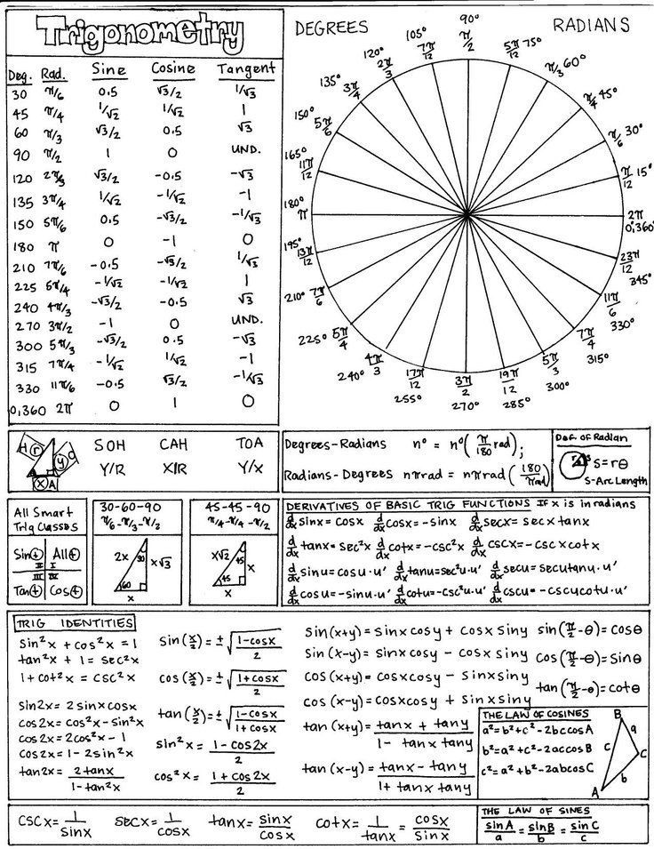
Tips
Use neat writing and a neat pen. Pencil is not recommended. Make sure you can read it.
Break into parts/chapters. You might even color-code the sections.
Include only the things you are having trouble remembering– don’t waste space on stuff you already understand well.
Practice using the reference sheet at least once. Try it on your old tests or the practice quizzes this week.

Slide 3
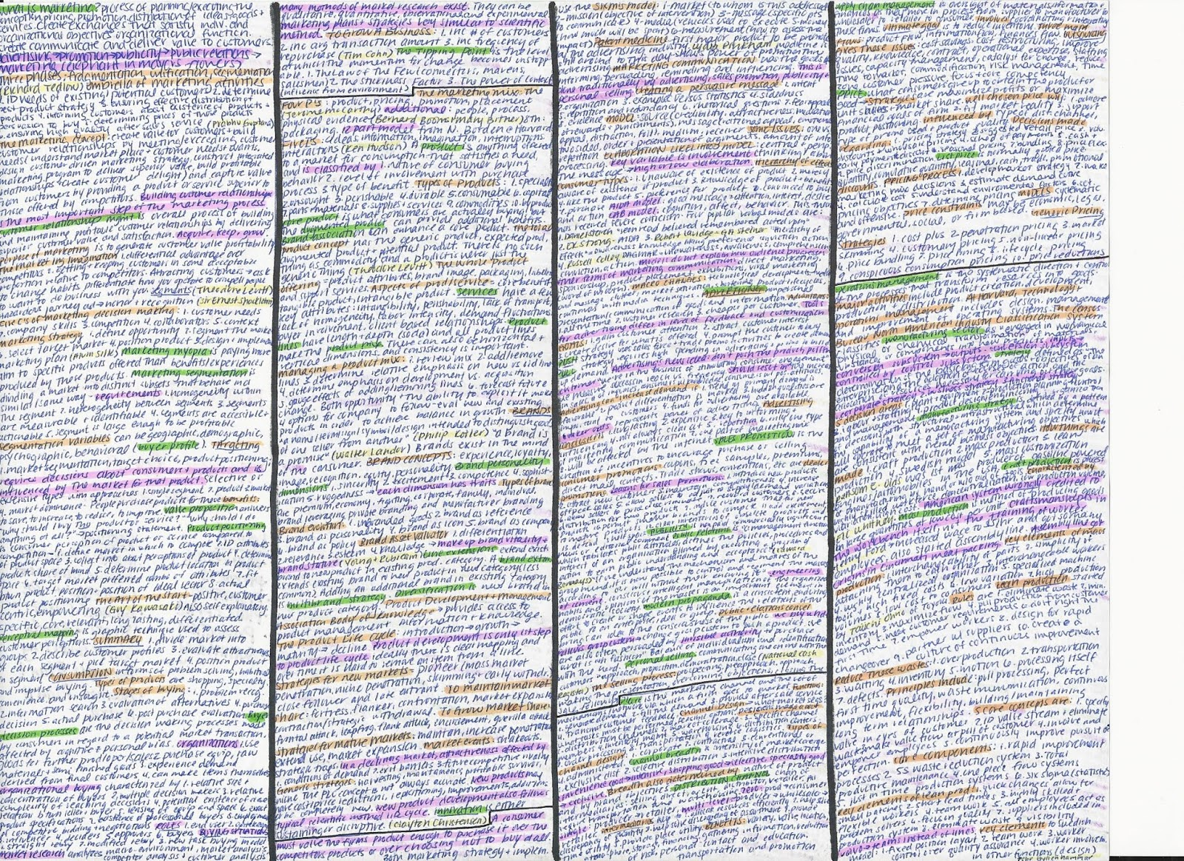
What do we like? What would we change?

Slide 4
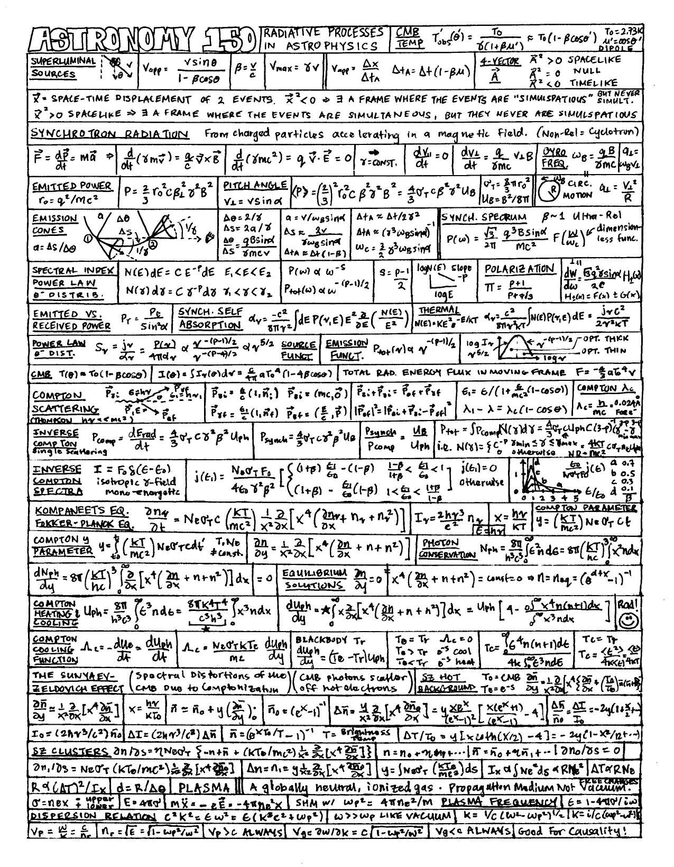
What do we like? What would we change?

Slide 5
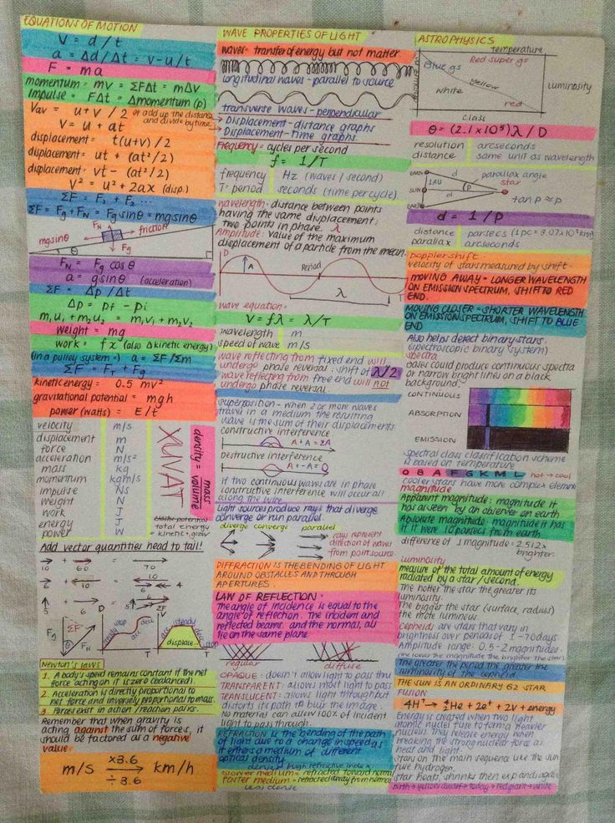
What do we like? What would we change?

Slide 6
Your Reference Sheet:
Can be a full sheet of 8.5 x 11 paper trifold, front and back
Each segment for a Unit (7 units so far, 2 that are small)
SHOULD NOT INCLUDE FORMULAS! You will get these on the exam.
SHOULD include graphs, diagrams, and examples
CAN include vocabulary and example problems
MUST BE written by you– no copy and pasting.
ABSOLUTELY MUST be finished AND approved by BOTH of us by 5/29/18

