Slide 1
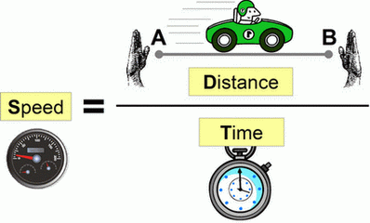
Chapter 11 – Motion Review

Slide 2
What is needed to describe motion?

Slide 3
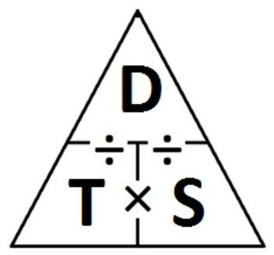

Slide 4
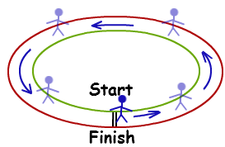
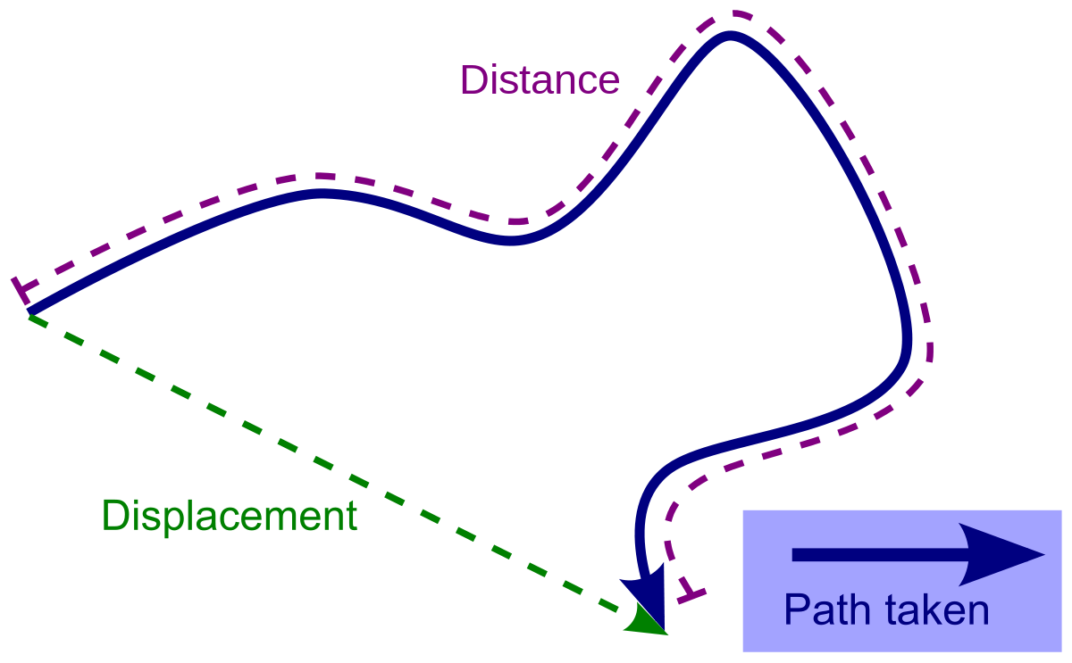

Slide 5
Acceleration

Slide 6
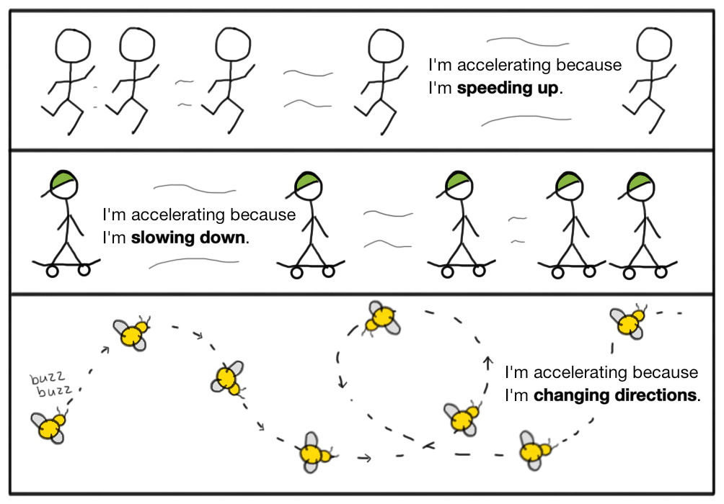

Slide 7
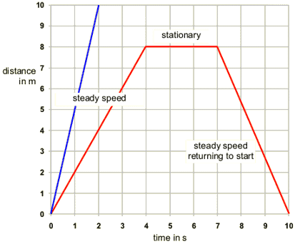

Slide 8
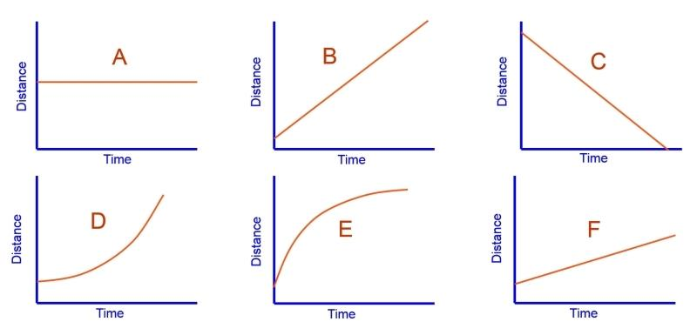
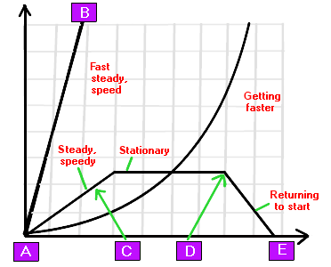

Slide 9
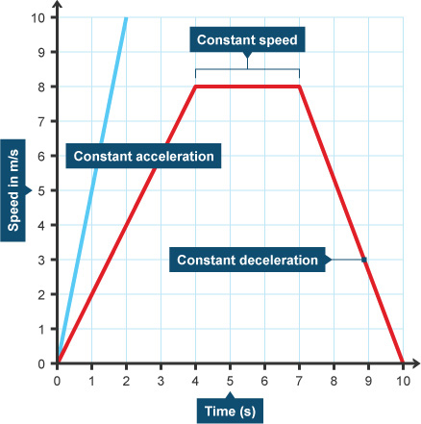

Slide 11
SI Units?
Distance – m
Displacement – m + direction
Speed – m/s
Time – s
Velocity – m/s + direction
Acceleration – m/s² + direction

Slide 12
What is a vector?

