Slide 3
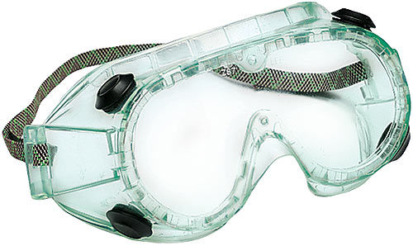
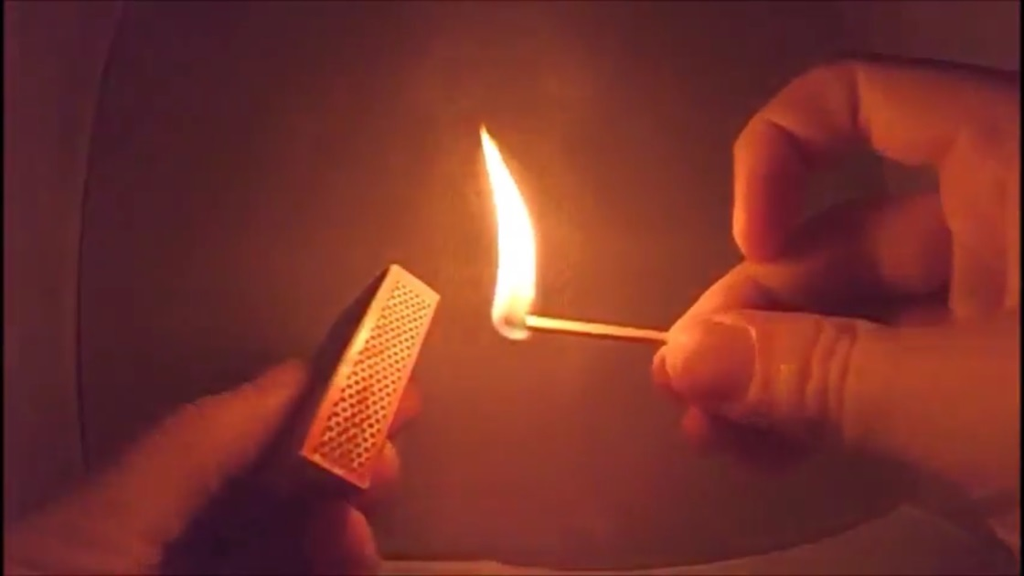
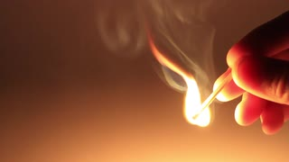
Keep flames away from hair, clothing, and paper. Do not point lit matches downward. Do not put matches in the sink – dispose of them in the water dishes provided. Goggles must be worn.

Slide 4
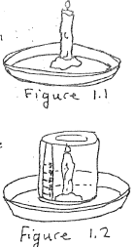
READ the entire procedure before constructing your hypothesis, and before taking any steps to complete the experiment.
Once you’ve read the procedure, predict what you think will happen by filling in your hypothesis below:
The water level in the dish will ( rise / drop ) because_________________.

Slide 5
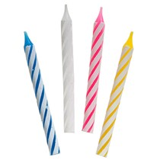
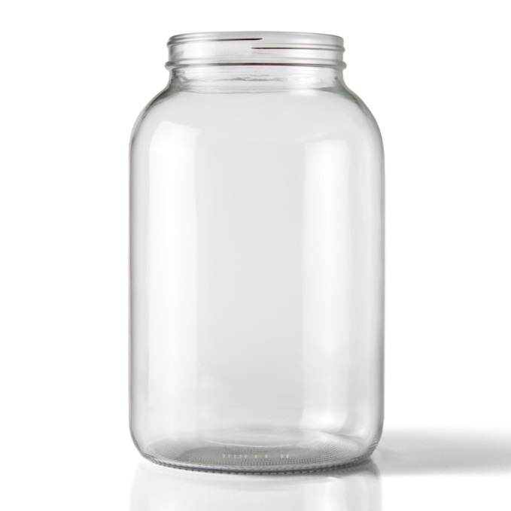
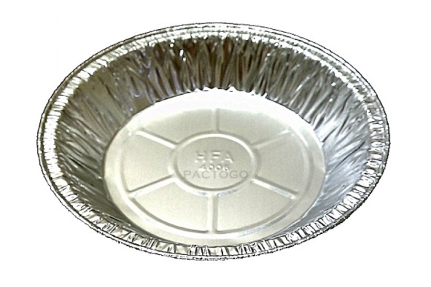
Clean-up: Dry jars and pie pans. Leave birthday candles as dry as possible.

